Slide 1


Applying for Secondary Schools 2025

Slide 2

Application Deadline
31 October 2024.

Slide 3
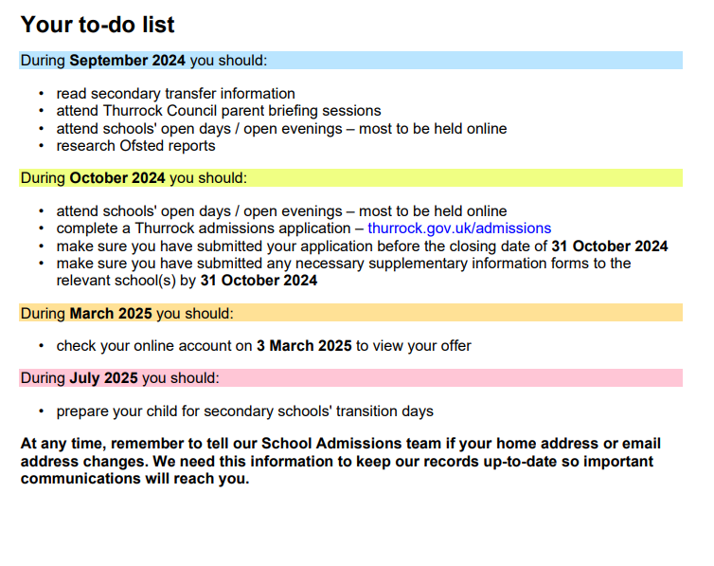
Admission timetable

Slide 4
On Line Briefing Sessions
Online briefing sessions
Thurrock Council are hosting 3 online briefing sessions to explain the admissions process, answer your questions and help you apply for a school place. These sessions do not promote any particular school but give an overview of the whole process. Session times are:
Wednesday 18 September 2024, 1pm to 2pm
Wednesday 18 September 2024, 4pm to 5pm
Wednesday 18 September 2024, 6:30pm to 7:30pm
Find the link on –
https://www.thurrock.gov.uk/secondary-school-admissions/applying-for-secondary-school-place

Slide 5
Apply online
The easiest way to apply is online – go to thurrock.gov.uk/admissions and follow the instructions
on screen to make your application.
Your login account for this service is separate to the login accounts you may use for other
Thurrock Council services, such as council tax, benefits or housing.
Once you create an account you will be able to complete an application, review, amend and submit it online.
You will get an automatic confirmation that your application has been received. Once you have submitted your application online, if you make any changes – for example, change preference order – you must re-submit the application.
If you change your email address, you must notify our School Admissions team by emailing - school.admissions@thurrock.gov.uk

Slide 6
If you are applying to out of Thurrock schools -
How to complete your application
We recommend you apply online at thurrock.gov.uk/admissions
Each local authority has its own application form, whether it is electronic or a paper copy. You
must complete the application for the local authority area in which you live, regardless of which schools you are applying for.
If you are a Thurrock resident and want to apply for schools outside Thurrock, you must do so on the Thurrock application.
It is important that the application is completed fully and accurately. Your application may be adversely affected if there are omissions or inaccuracies

Slide 7
Home address
Thurrock normally process applications on the basis of the child's home address at the time of application and offer.
The home address is the address where the child is a permanent resident, or where the child is ordinarily resident. This is usually the address of the parent, or carer with parental responsibility. The adult with whom the child is ordinarily resident would receive Child Benefit for the child.

Slide 8
Late applications
If you miss the closing date Applications received after the closing date will be considered after those that are received on time and after the first round of offers have been made.
Last year Thurrock Council co-ordinated the admissions to Thurrock secondary schools and 77.7% of parents who applied on time had their first preference met in the initial round of offers.

Slide 9
Your preferred schools
You are invited to name up to six preferences.
You must name the schools in the order that you prefer them, with your most preferred school named first.
All preferences are given equal weight and schools will not know your order of preference on your application.
You do not gain any advantage if you name only one or two preferences, or if you name the same school more than once.
Whilst the local authority has a responsibility to make a place available for your child, it does not necessarily have to be at one of your named preferences, nor at your nearest school. If you meet the oversubscription criteria for more than one school you will be offered the one that is higher on your list of preferences.

Slide 10
Applying for a Catholic Secondary School –
You may need to complete a Supplementary Information Form to show you are a practicing Catholic / Christian and this must be signed by your parish Priest / Minister
This information should be submitted to the school by 31 October 2024

Slide 11
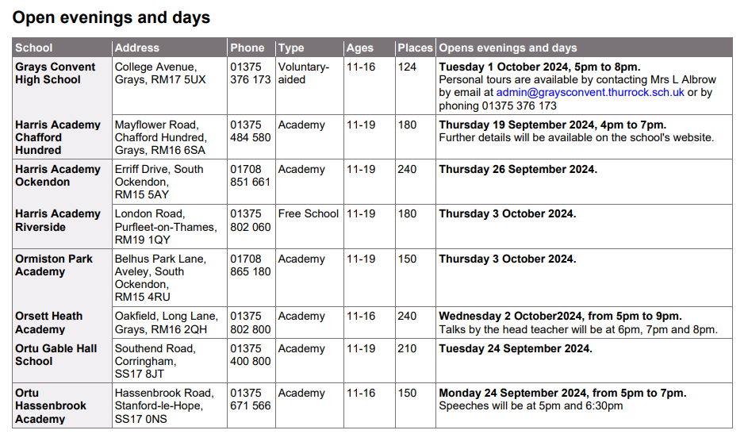
Open Evenings

Slide 12
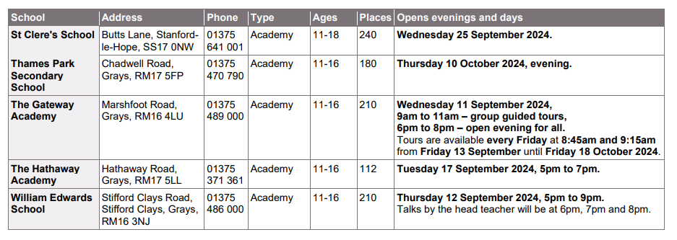

Slide 13
Your Preferred Schools
You are invited to name up to six preferences. You must name the schools in the order that you prefer them, with your most preferred school named first.
All preferences are given equal weight and schools will not know your order of preference on your application. You do not gain any advantage if you only name one or two preferences, or if you name the same school more than once.
If you meet the oversubscription criteria for more than one school you will be offered the one that is higher on your list of preferences.
Reason for preference
There is space on the application for you to give a reason for naming a school as a preference and this will be shared with the relevant school(s). Whilst a school will look at what you put here, this alone would not normally give priority for a place. If you wish to apply under any school's special criterion, you must make sure you comply with the school's requirements for supporting evidence.

Slide 14
Assessments of ability or aptitude
Some selective schools may ask your child to undergo an assessment of their ability or aptitude for a particular discipline. This is stated in the individual schools' admissions criteria.
Results should all come through before the 31st October, this will help you identify your choices on your application.
Include the grammar school choice on your application but include mainstream schools also

Slide 15
Getting Ready
You should start by gathering as much information about each school as possible. Information is available from:
• the school information pages
• school prospectuses
• school websites
• open evenings
• Ofsted reports – available from the school or online at www.ofsted.gov.uk

Slide 16
Making sure your child is ready…
SAT’s preparation

