Slide 1
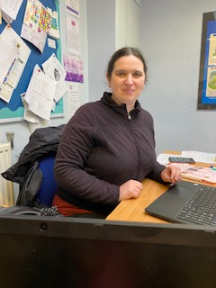








Christus Catholic Trust (CCT)
Parent SEND Forum
Meet the new CCT Head of SEND and Inclusion – Heather Westrop
Share your views on SEND in your child’s school
Discuss what support you would like from the trust
WEDNESDAY 8th MAY
9:30am or 6:30pm virtually on MS TEAMS
Email: hwestrop@christus.org.uk to book your place stating which session you would like to attend, your name and child's school.

